Slide 1
Address Register in connection with Cadastre
Viesturs Aigars
Permanent Committee on Cadastre, Rome, 21.11.2014.

Slide 2
Content
Overview of address register
Data workflows
Interconnection with other registers
Future development

Slide 3
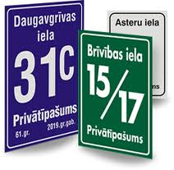
What is address?
The address is hierarchically arranged names and numbers, which provides exact location
Akas iela 2 – 10, Rauda, Tukuma novads
Street
Apartment number
Village
County
House number

Slide 4
Address register,
overview
State Address Register
State Information System
Founded at 2001
Covers whole country
100% digital
Text and maps
Notes:
Why it was founded? Idea of Megasystem and address as an attribute that links all together.

Slide 5
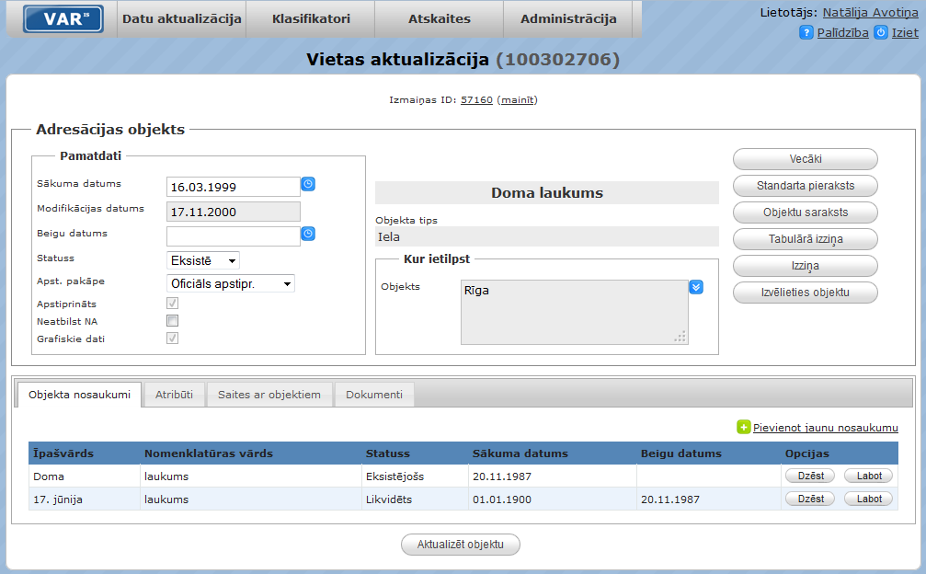

Slide 7
Address register,
what can have an address?
County
City
Civil parish (part of County)
Town
Village
Street
Land parcel (provided for erection of buildings)
Buildings
Apartments

Slide 8
Address register, statistic
Activity:
33 139
new 13 079

Slide 9
Address register,
how it was made
Post
Cadastre
State Revenue Service
Address register
State Enterprise Register
Population register
Social Security system
Municipalities
(119)
2001 0% from municipalities
2013 64% from municipalities

Slide 10
Address register, workflow
Municipalities
(119)
Paper or digitally signed e-document
Address register

Slide 11
Address register,
how the address are born?
Municipality
Address register
Address 1
Address 2
Cadastre
Cadastral Surveying
Address 3
Address 4

Slide 12
Address register and Cadastre
Address register
Cadastre
1. Before registration in Address register every address is compared with Cadastre;
a. No object in Cadastre; planned land parcels and buildings
b. It’s a land parcel without building
2. In Cadastre you can only add an address which exists in Address register
Notes:
We may say that from Cadastre point of you an address is one important attribute to cadastre objects;

Slide 13
Address register and Cadastre
Mobile application Kadastrs.lv
iOS
Android
Windows Phone

Slide 14
Biggest users
Regular users: 119 Municipalities 23 Government institutions
31 Companies
Latvian Geospatial Information Agency
State Education Development Agency
Municipalities
State Employment Agency
Information Centre of the Ministry of the Interior
State Emergency Medical Service
Central Statistical Bureau
Population Register
State Regional Development Agency
State Revenue Service
Address register
Rural Support Service
State Enterprise Register
State Electronic Communications Office
Health Inspectorate
Centre of Information Systems of Culture
The Court Administration (Land Register, Court Information system)
Agricultural Data Centre
State Inspection for Heritage protection
Lattelecom
(communications)
Latvijas Gāze (gas supply)
Rīgas ūdens
(water supply)

Slide 15
How to register a company?
log in
verify
Address register
search
persons name
=
owner name
Cadastre
State Enterprise Register
Notes:
jaasaliek animaacija

Slide 16
Address register
Address register,
citizens and taxes
Population register
declare
verify
pay taxes
person & address
The Treasury
€
municipality 1
€
municipality 2
€
municipality 3
Notes:
jaasaliek animaacija

Slide 17
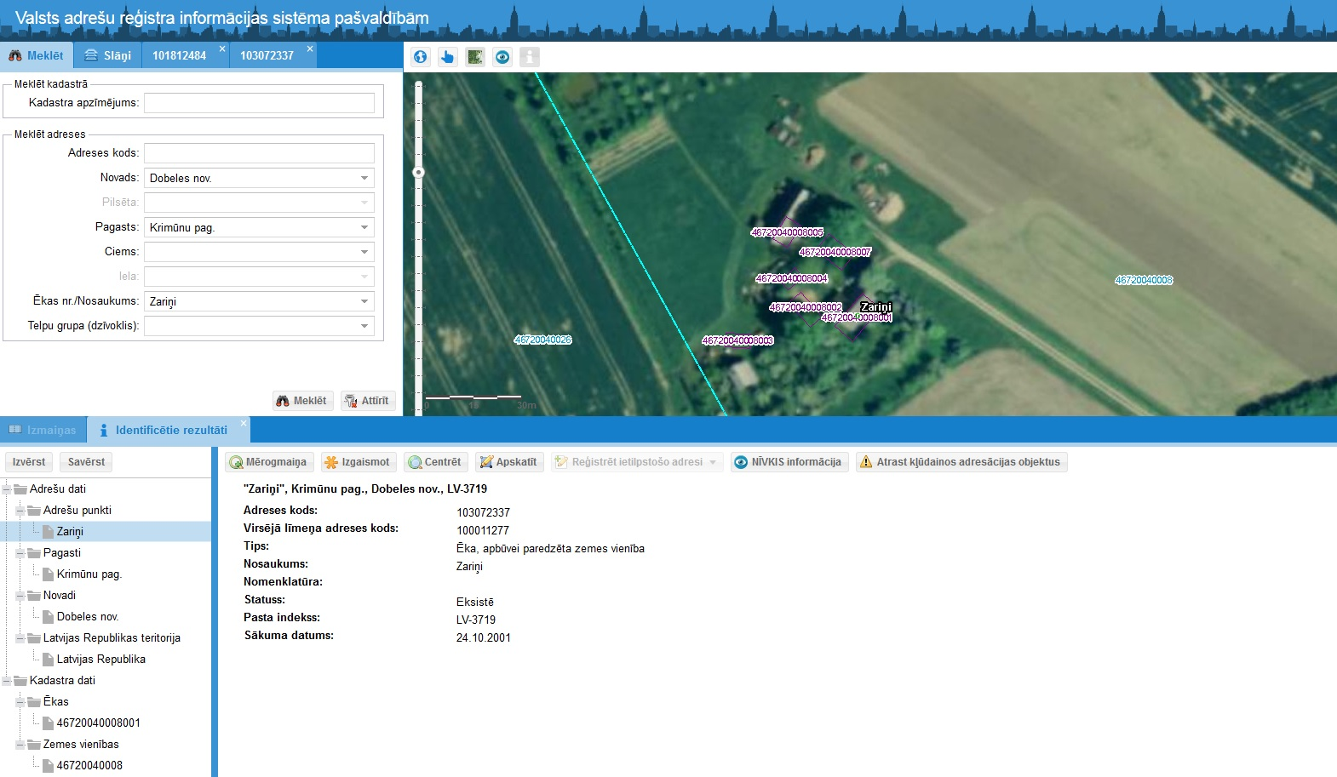
Address register,
future
Municipalities will be able to input an address themselves

Slide 18
Viesturs Aigars
Project Manager
State Land Service of Latvia
viesturs.aigars@vzd.gov.lv

